Slide 1
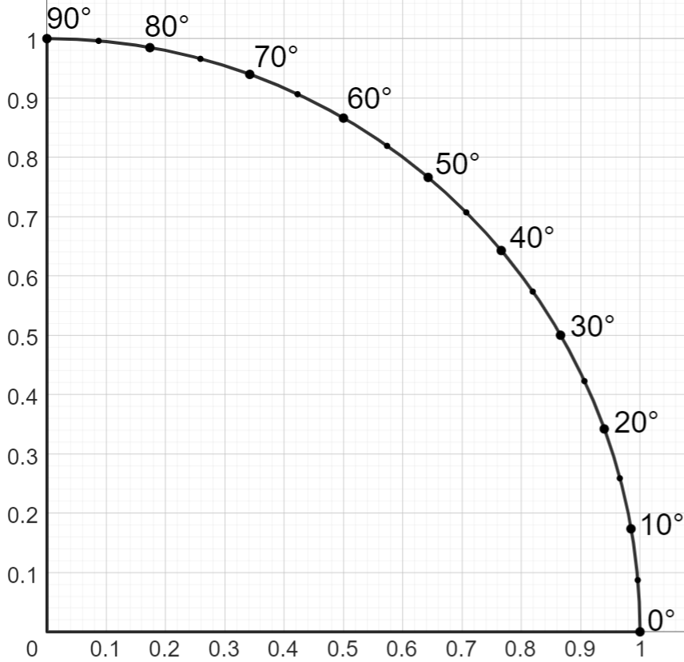
Scaling the right-angled triangle from the unit circle
Task A: Labelling sides of a right-angled triangle
1) Label the sides of each triangle with the words ‘opposite’, ‘adjacent’ and ‘hypotenuse’. In parts (g) and (h), also mark the appropriate angle with θ.
a)
b)
c)
adjacent
d)
opposite
hypotenuse
θ
hypotenuse
θ
opposite
adjacent
hypotenuse
opposite
hypotenuse
adjacent
θ
opposite
θ
adjacent
e)
f)
g)
h)
hypotenuse
adjacent
adjacent
θ
opposite
θ
hypotenuse
θ
θ
hypotenuse
adjacent
adjacent
opposite
hypotenuse
opposite
opposite
Task B: Using sine and cosine from the unit circle
1) Use this sector of the unit circle to find the missing lengths on each triangle.
sin(θ)
a)
b)
10 m
8.7 m
10 m
30°
5 m
8.7 m
60°
5 m
c)
5.7 m
d)
12 m
45°
5.7 m
15°
8 m
3.1 m
11.6 m
cos(θ)

Slide 2
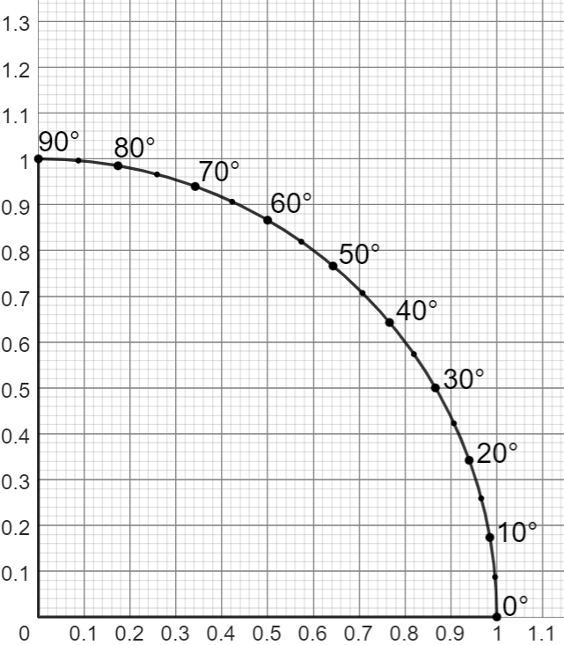
Scaling the right-angled triangle from the unit circle
2) Use this sector of the unit circle to find the value of each unknown.
sin(θ)
a)
b)
a m
b m
6 m
50°
50°
a = 7.8
6 m
b = 9.3
c)
c m
d)
20 m
10 m
20°
d°
15 m
c = 14.1
d = 30
cos(θ)
Task C: Using tangent from the unit circle
1) Use this sector of the unit circle to find the value of each unknown.
y
a)
b)
a m
10 m
50°
50°
10 m
b m
a = 11.9
b = 8.4
c)
20°
d)
4 m
c m
d m
9 m
30°
c = 3.3
d = 6.9
x
Mathematics in Education and Industry
v2.3

